Slide 1
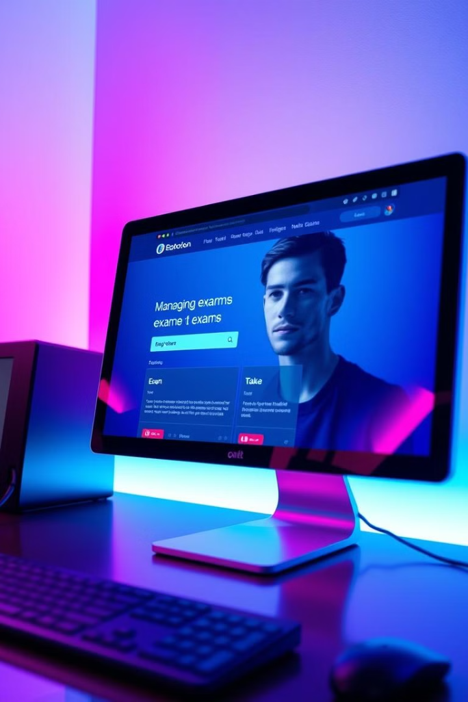
Student Examination Console Project: A JDBC and MySQL Implementation
This project develops a robust examination system for students, powered by a MySQL database and JDBC for seamless data interaction. The system enables admins to create exams, add questions, and view results, while students can take exams, view scores, and access their information.

Slide 2


Project Overview
1
Purpose
2
Features
The project aims to provide a user-friendly and efficient system for managing student examinations, simplifying the process for both administrators and students.
The system features a secure login system, exam creation, question management, result tracking, and clear user interfaces for both administrators and students.
3
Technology Stack
4
Benefits
The project leverages Java, JDBC, MySQL, and a console-based UI for creating a robust and functional examination system.
This project brings numerous benefits, such as improved exam management, centralized data storage, enhanced efficiency, and streamlined user experience.

Slide 3
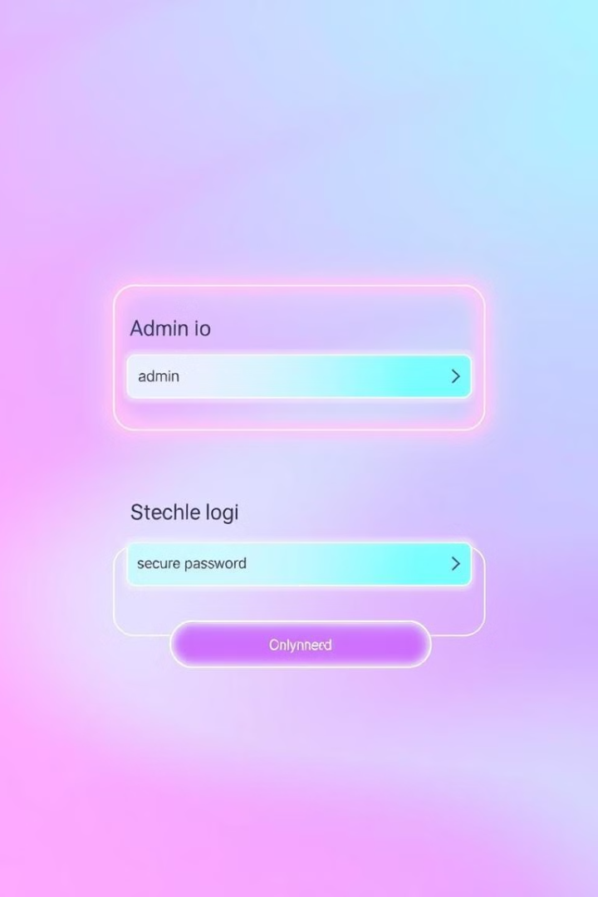
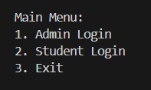
Login System
Admin Login
Student Login
Admins log in with their unique username and password, granting access to a dedicated admin menu for managing exams and user accounts.
Students log in using their name, class, and enrollment number, gaining access to their specific exams, scores, and personal information.

Slide 4
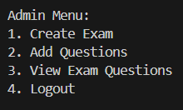
Admin Menu
Create Exam
Manage Questions
View Results
Admins can create new exams by defining their title, description, and other relevant details, allowing for easy management of the examination process.
Admins have the capability to add questions to exams, specifying correct answers, difficulty levels, and other parameters, ensuring a comprehensive and well-structured question bank.
Admins can access and review the results of completed exams, gaining valuable insights into student performance and identifying areas for improvement.

Slide 5
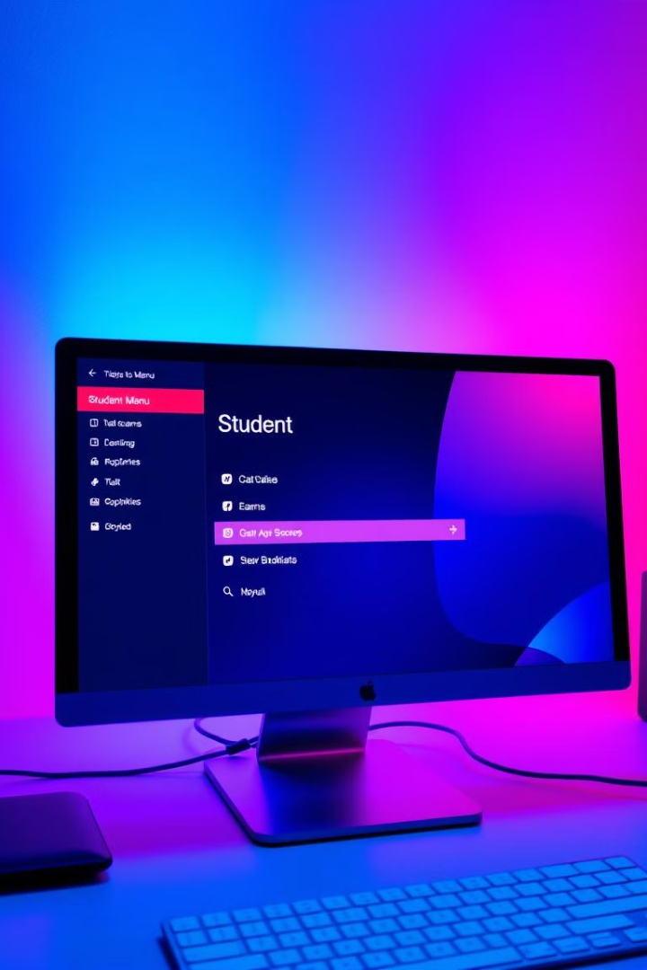
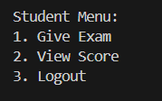
Student Menu
1
Give Exam
2
View Score
Students can Give exams by selecting the desired exam ID, accessing the questions, and submitting their answers within the designated time frame.
Students have access to their scores for completed exams, providing them with valuable feedback on their performance and areas for improvement.

Slide 6

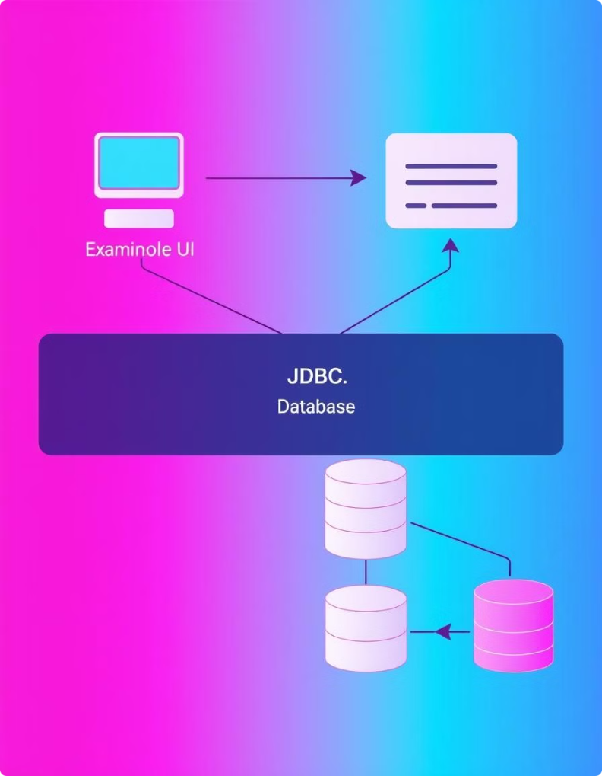




System Architecture
Console UI
The user interface provides a console-based environment for interaction with the system, allowing users to navigate menus, input data, and view results.
Examination Login
The login system authenticates users based on their credentials, providing access to appropriate menus and functionalities.
JDBC/Database Connectivity
JDBC acts as a bridge, connecting the Java application to the MySQL database, enabling data retrieval, storage, and manipulation.
MySQL Database
The database stores and manages all relevant data, including user credentials, exams, questions, answers, and scores, ensuring data integrity and consistency.

Slide 7
Flow Diagram:-
Main Menu
Login
Admin Menu
Student Menu
Exit
Create Exams
Add Question to exam
View all Question
Give Exams
View Obtain Marks
Exit from the Program
Logout
Logout
Data Store in Database

Slide 8
Entity-Relationship Diagram:-
Entity | Attributes | Relationship
User | (Admin):Admin ID Name , Password (Student):Student Id, Name , Class , En. No. Or Roll No. | Has Many User , Has Different credentials
Exams | Exam name , Exam Id | Has Many Exams , Has different Exams Ids
Questions | Question Id , Exam ID , Correct Answer | Many Question in one Exam
Answers | Answer Id, Answer , Student ID, Question ID, Exam ID | Answer Entered by the Student
Result | Student Id , Exam Id , Score | Every Student Can Appear the Exam Once

Slide 9
User Interface Screenshot
Student Taking Exam
Admin Managing Exams
The user interface provides a clear view of the exam questions, allowing students to select answers and submit their responses.
Admins have a dedicated interface for creating exams, adding questions, and viewing results, ensuring efficient management of the examination process.

Slide 10

Live Run Example
A live run example showcases the functionality and user experience of the Student Examination Console Project, highlighting the seamless integration of the console UI, database connectivity, and exam management features, providing a clear and comprehensive demonstration of the project's capabilities.

Slide 11
Thank You
Thank you for your time and attention.
We are open to questions and feedback regarding this project.
We look forward to discussing the next steps.

